Slide 1


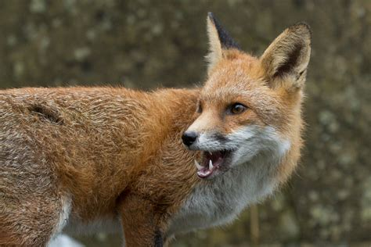

Fox
New pa ra graph

Slide 2

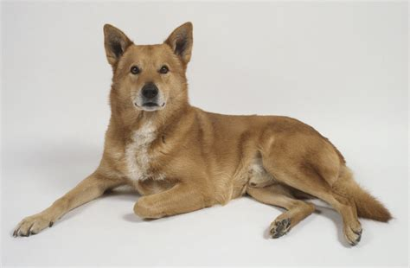

Dog
New pa ra graph

